Slide 1
THINKING INSIDE THE BOX

Slide 2
The parts of an element box
Box dimensions
Padding
Borders
Outlines
Margins
Display roles
Drop shadows

Slide 3
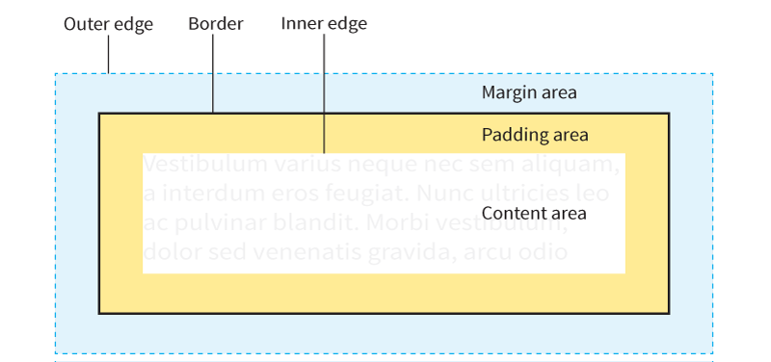
The Parts of an Element Box
NOTE: The margin is indicated with a blue shade and outline, but is invisible in the layout.

Slide 4
Specifying Box Dimensions
width
Values: Length, percentage, auto
height
Values: Length, percentage, auto
Specify the dimensions of an element box with width and height properties

Slide 5
Box Sizing Models
box-sizing
Values: content-box, border-box
There are two methods for sizing an element box, specified with the box-sizing attribute:
Content-box sizing (default)
Applies width and height values to the content box only
Border-box sizing
Applies width and height values to the border box (including the padding and content)

Slide 6
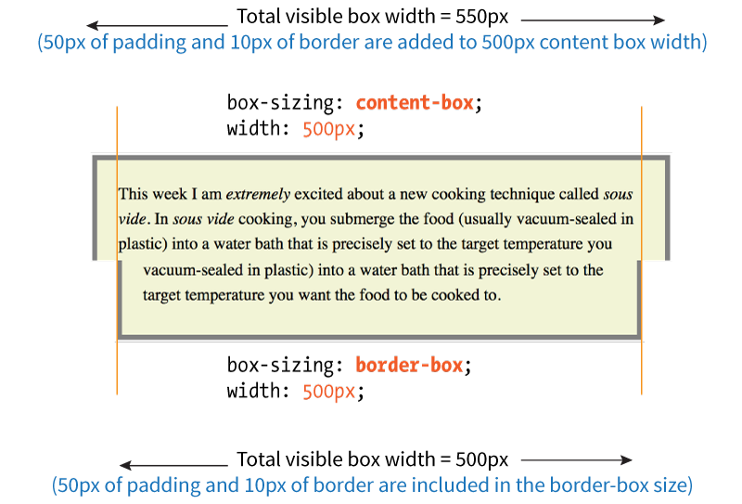
Box Sizing Models Compared

Slide 7
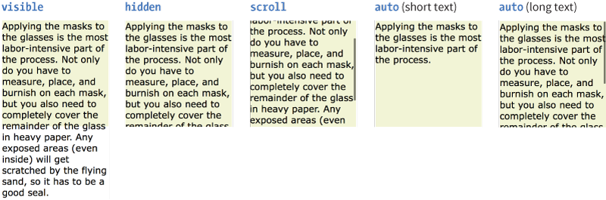
Overflow
overflow
Values: visible, hidden, scroll, auto
Specifies what to do when content doesn’t fit in a sized element box:

Slide 8
Padding
padding, padding-top, padding-right, padding-bottom, padding-left
Values: Length, percentage
An amount of space between the content area and the border (or the space the border would be if one isn’t specified).
You can add padding to one side at a time, or on all sides with the padding shorthand property.

Slide 9
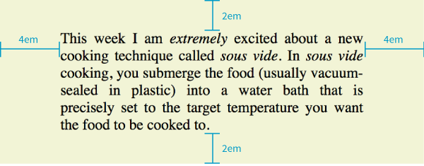
Padding (cont’d)
blockquote {
padding-top: 2em;
padding-right: 4em;
padding-bottom: 2em;
padding-left: 4em;
background-color: #D098D4; /*light green*/
}

Slide 10
Shorthand padding Property
The padding property adds space around 1, 2, 3, or 4 sides of the content using the clockwise top, right, bottom, left (TRouBLe) order:
padding: top right bottom left;
padding: 2em 4em 2em 4em;
(this shorthand produces the same result as the example on the previous slide)

Slide 11
Shorthand padding Property (cont’d)
If the left and right sides are the same, you can omit the last value, and the second value will be applied on both the left and right sides:
padding: top right+left bottom;
padding: 2em 4em 2em;
(this shorthand produces the same result as the examples on the two previous slides)

Slide 12
Shorthand padding Property (cont’d)
If the top and and bottom sides are also the same, you can omit the third value, and the first value will be applied on both the top and bottom:
padding: top+bottom right+left;
padding: 2em 4em;
(same result as previous examples)
If all sides are the same, provide one value, and it’s applied to all sides:
padding: all sides;
padding: 2em;
(2em padding all around)

Slide 13
Borders
A border is a line drawn around the content area and its (optional) padding.
The thickness of the border is included in the dimensions of the element box.
You define style, width (thickness), and color for borders.
Borders can be applied to single sides or all around

Slide 14
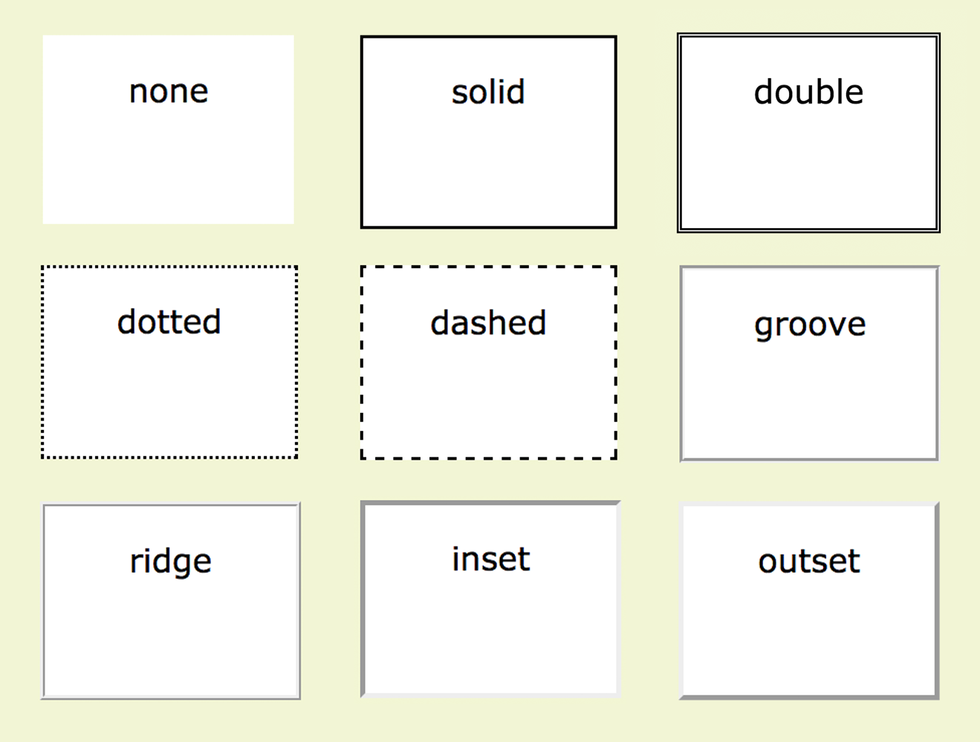
Border Style
border-style, border-top-style, border-right-style, border-bottom-style, border-left-style
Values: none, solid, hidden, dotted, dashed, double, groove, ridge, inset, outset
NOTE: The default is none, so if you don’t define a border style, it won’t appear.

Slide 15
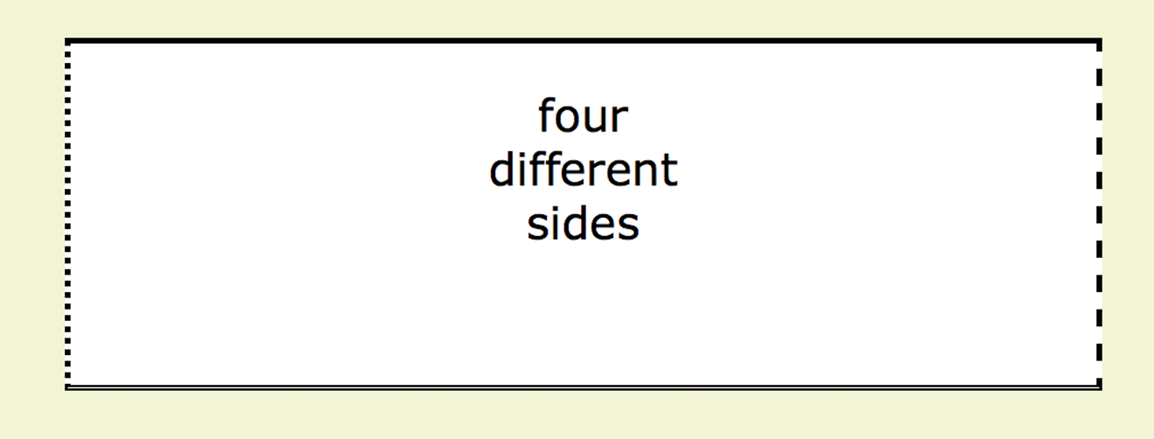
Border Style
border-style
The border-style shorthand uses the clockwise (TRouBLe) shorthand order. The following rules have the same effect:
div#silly {
border-top-style: solid;
border-right-style: dashed;
border-bottom-style: double;
border-left-style: dotted;
width: 300px;
height: 100px;
}
div#silly {
border-style: solid dashed double dotted;
}

Slide 16
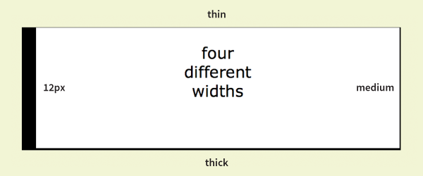
Border Width
border-width, border-top-width, border-right-width, border-bottom-width, border-left-width
Values: Length, thin, medium, thick
The border-width shorthand uses the clockwise (TRouBLe) order:
div#help {
border-width: thin medium thick 12px;
border-style: solid;
width: 300px;
height: 100px;
}
NOTE: The border-style property is required for the border to be rendered.

Slide 17
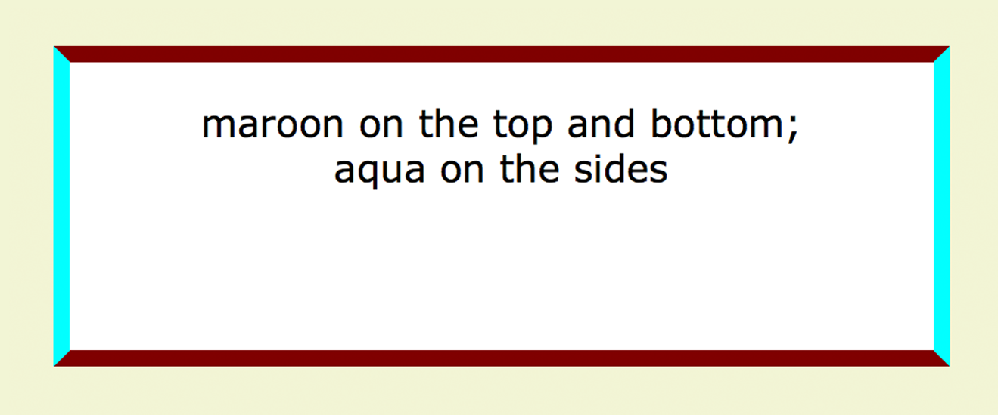
Border Color
border-color, border-top-color, border-right-color, border-bottom-color, border-left-color
Values: Color value (named or numeric)
The border-color properties override the color property:
div#special {
border-color: maroon aqua;
border-style: solid;
border-width: 6px;
width: 300px;
height: 100px;
}
NOTE: The border-style property is required for the border to be rendered.

Slide 18
Border Shorthand Properties
border, border-top, border-right, border-bottom, border-left
Values: border-style border-width border-color
Combine style, width, and color values in shorthand properties for each side or all around (border):
p.example {
border: 2px dotted aqua;
}
NOTE: The border-style property must be included in the shorthand for the border to be rendered.

Slide 19
Border Radius (Rounded Corners)
border-radius
Values: 1, 2, 3, or 4 length or percentage values
The border-radius property rounds off the corners of an element.
The value is a length or percentage value reflecting the radius of the curve.
Providing one value makes all the corners the same.
Four values are applied clockwise, starting from the top-left corner.

Slide 20
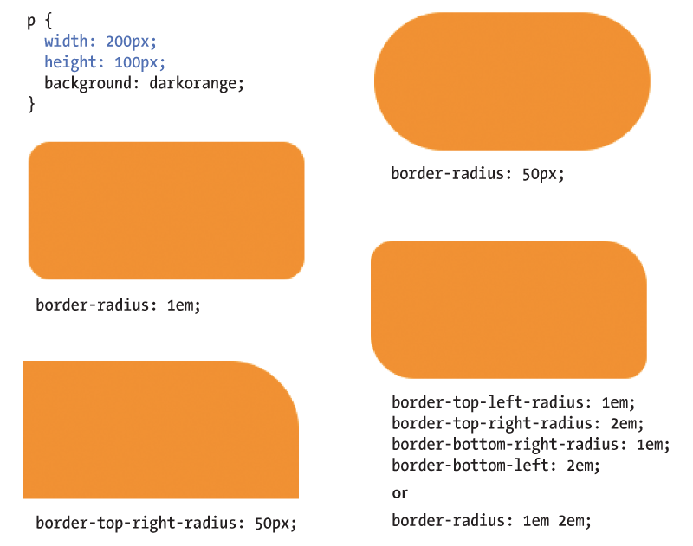
Border Radius (cont’d)

Slide 21
Margins
margin, margin-top, margin-right, margin-bottom, margin-left
Values: Length, percentage
The margin is an amount of space added on the outside of the border. They keep elements from bumping into one another or the edge of the viewport.
The shorthand margin property works the same as the padding shorthand. Values are applied clockwise (TRouBLe order) and are repeated if fewer than 4 values are supplied.

Slide 22
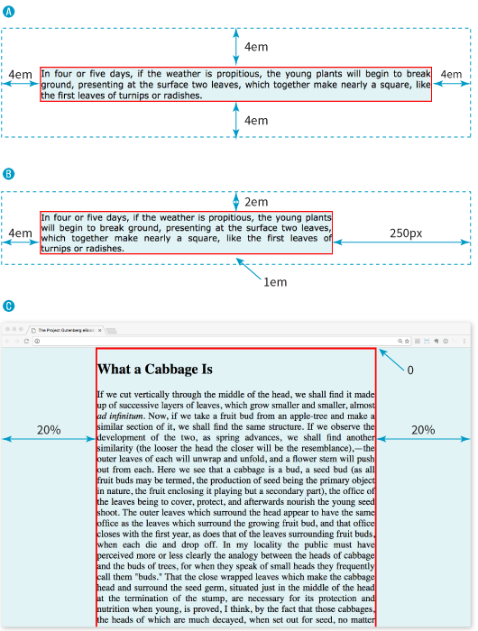
Margins (cont’d)
A p#A {
margin: 4em;
border: 2px solid red;
background: #e2f3f5;
}
B p#B {
margin-top: 2em;
margin-right: 250px;
margin-bottom: 1em;
margin-left: 4em;
border: 2px solid red;
background: #e2f3f5;
}
C body {
margin: 0 20%;
border: 3px solid red;
background-color: #e2f3f5;
}

Slide 23
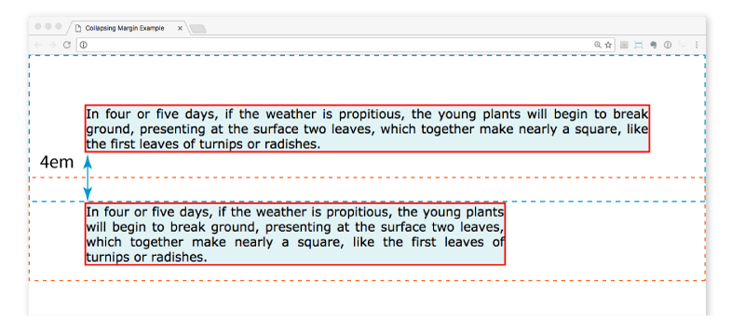
Margins (cont’d)
Top and bottom margins of neighboring elements collapse (they overlap instead of accumulating).
The top element has a bottom margin of 4em. The bottom element has a top margin of 2em. The resulting margin is 4em (the largest value).

Slide 24
Assigning Display Types
display
Values: inline | block | run-in | flex | grid | flow | flow-root | list-item | table | table-row-group | table-header-group | table-footer-group | table-row | table-cell | table-column-group | table-column | table-caption | ruby | ruby-base | ruby-text | ruby-base-container | ruby-text-container | inline-block | inline-table | inline-flex | inline-grid | contents | none
Assigns a display type that determines how the element box behaves in layouts.
Examples:
Make li (normally block elements) into inline elements so they line up in a horizontal menu: nav li { display: inline; }
Make an anchor (a) element (normally inline) display as a block so you can give it a width and height: nav li a { display: block; }

Slide 25
Box Drop Shadows
box-shadow
Values: horizontal-offset vertical-offset blur-distance spread-distance color inset, none
Applies a drop shadow around the visible element box.
The values are a horizontal and vertical offset, optional blur and spread values (in pixels), a color value, and the option to make it appear inset.

Slide 26
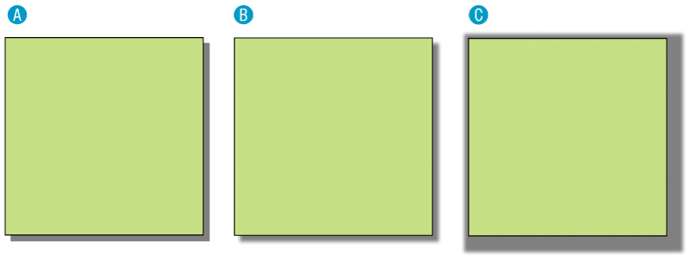
Box Drop Shadows (cont’d)
A box-shadow: 6px 6px gray;
B box-shadow: 6px 6px 5px gray; /* 5 pixel blur */
C box-shadow: 6px 6px 5px 10px gray; /* 5px blur,10px spread */

Slide 27
15 FLOATING AND POSITIONING

Slide 28
Understanding normal flow
Floating elements to the left and right
Clearing and containing floated elements
Text wrap shapes
Positioning: Absolute, relative, fixed

Slide 29
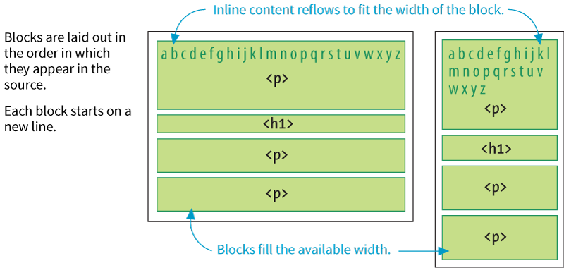
Normal Flow
In the normal flow, elements are laid out from top to bottom in the order in which they appear in the source and from left to right (in left-to-right reading languages).

Slide 30
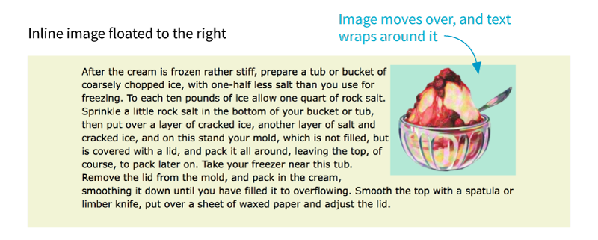
Floating
float
Values: left, right, none
Moves an element as far as possible to the left or right and allows the following content to wrap around it:
img { float: right; }

Slide 31
Floating (cont’d)
Floated elements are removed from the normal flow but influence the surrounding content.
Floated elements stay within the content area of the element that contains it.
Margins are always maintained (they don’t collapse) on all sides of floated elements.
You must provide a width for a floated text element (because default width is auto).
Elements don’t float higher than their reference in the source.

Slide 32
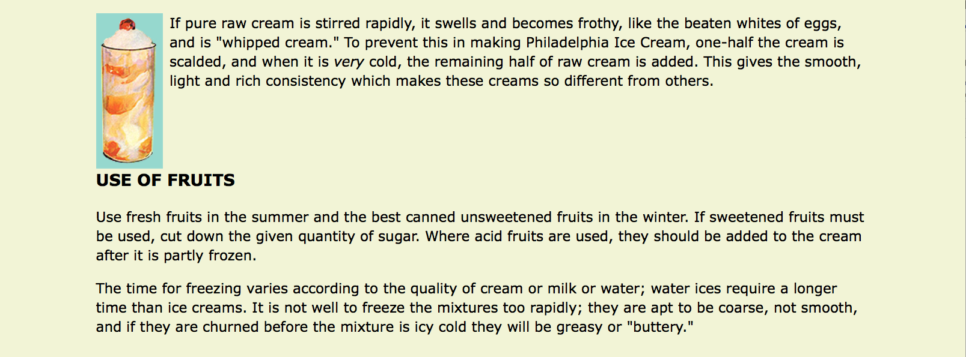
Clearing Floated Elements
clear
Values: left, right, both, none
Prevents an element from appearing next to a floated element and forces it to start against the next available “clear” space
img {
float: left;
margin-right: .5em;
}
h2 {
clear: left;
margin-top: 2em;
}
(The h2 is “cleared” and starts below the floated element.)

Slide 33
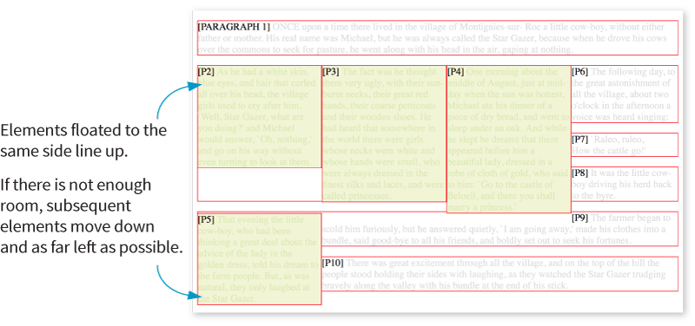
Floating Multiple Elements
When you float multiple elements, browsers follow rules in the spec to ensure they don’t overlap.
Floated elements will be placed as far left or right (as specified) and as high up as space allows.

Slide 34
CSS Shapes (Text Wrap)
shape-outside
Values: none, circle(), ellipse(), polygon(), url(), [margin-box | padding-box | content-box ]
Changes the shape of the text wrap to a circle or ellipse, a complex path, or based on transparent areas in an image
shape-margin
Values: length, percentage
Specifies an amount of space to hold between the image and the wrapped text

Slide 35
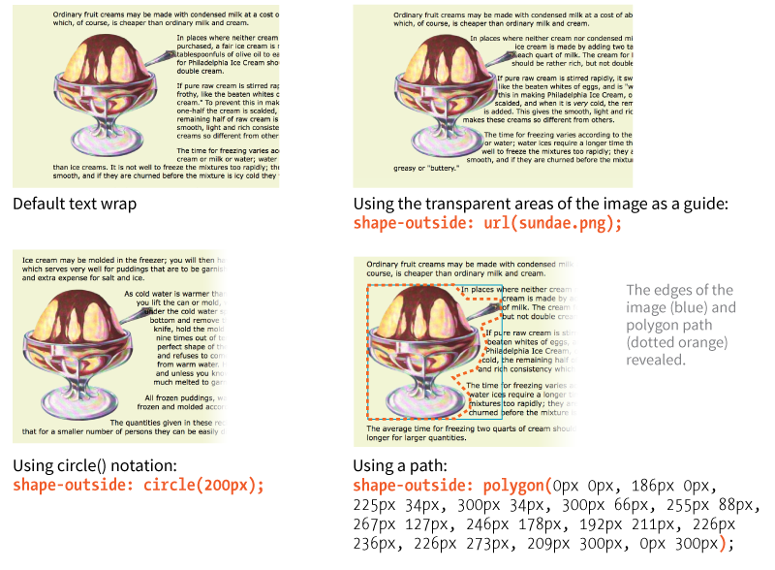
CSS Shapes (cont’d)

Slide 36
Positioning
position
Values: static, relative, absolute, fixed, sticky
Indicates that an element is to be positioned and specifies which positioning method to use
top, right, bottom, left
Values: length, percentage, auto
Offset properties that provide the distance the element should be moved away from that respective edge

Slide 37
Types of Positioning
Static: The default position in the flow
Relative: Moves the element relative to its original position
Absolute: Removes the element from the flow and places it relative to the viewport or other containing element
Fixed: Element stays in one position relative to the viewport
Sticky: Element starts in the flow but stays fixed once it scrolls to a particular position relative to the viewport

Slide 38
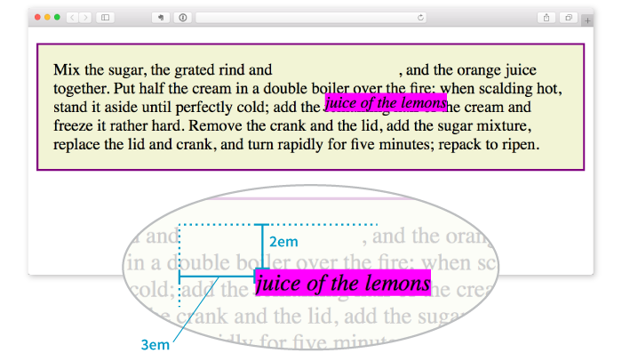
Relative Positioning
Moves the element relative to its original position
The space it originally occupied is preserved.
em {
position: relative;
top: 2em; /* moves it down */
left: 3em; /* moves it right */
background-color: fuchsia;
}

Slide 39
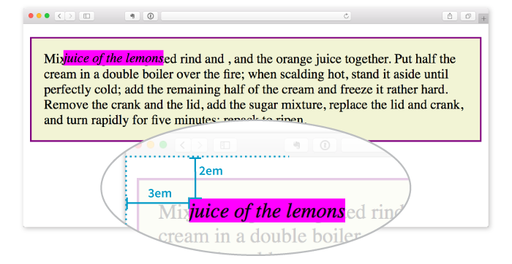
Absolute Positioning
Moves the element relative to the viewport or containing block element
The space it originally occupied is closed up.
em {
position: absolute;
top: 2em;
left: 3em;
background-color: fuchsia;
}

Slide 40
Containing Blocks
A positioned element serves as a containing block (or positioning context) for the elements it contains.
If a positioned element has an ancestor that has its position set to relative, absolute, or fixed, then its position will be relative to that containing block element.
If a positioned element is not contained within another positioned element, then it is placed relative to the initial containing block (the html element) and the viewport.

Slide 41
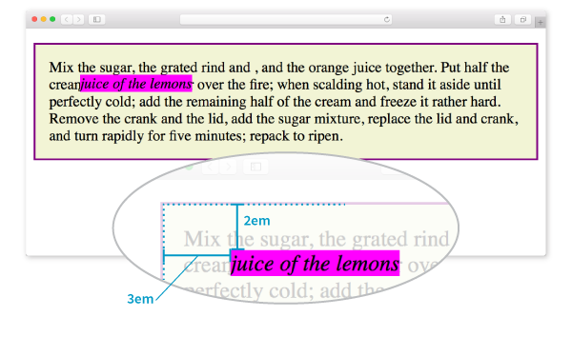
Containing Blocks (cont’d.)
p {
position: relative;
padding: 15px;
background-color: #F2F5D5;
border: 2px solid purple;
}
em {
position: absolute;
top: 2em;
left: 3em;
background-color: fuchsia;
}
The relatively positioned p element acts as a containing block for the em element.

Slide 42
Specifying Position
Position can be specified in length measurements (like pixels) or percentages.
The measurement moves it away from the positioning offset property provided (i.e., top: 200px; moves the element DOWN from the top edge).
Be careful not to overspecify. Two offset properties are usually enough.

Slide 43
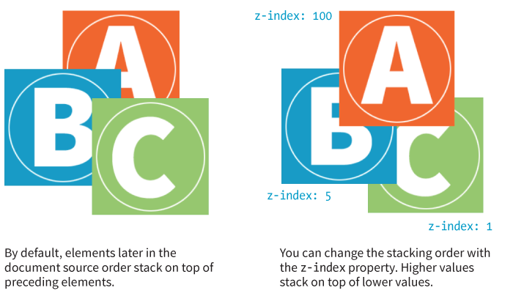
Stacking Order
z-index
Values: Number, auto

Slide 44
16A CSS LAYOUT WITH FLEXBOX

Slide 45
Flexbox terminology
Flexbox containers
Flow: Flow direction and text wrap
Alignment on main and cross axes
Specifying how items in a flexbox "flex"
Changing the order of flex items

Slide 46
About Flexbox
Flexbox is a display mode that lays out elements along one axis (horizontal or vertical).
Useful for menu options, galleries, product listings, etc.
Items in a flexbox can expand, shrink, and/or wrap onto multiple lines, making it a great tool for responsive layouts.
Items can be reordered, so they aren't tied to the source order.
Flexbox can be used for individual components on a page or the whole page layout.

Slide 47
Flexbox Container
display: flex
To turn on Flexbox mode, set the element’s display to flex.
This makes the element a flexbox container.
All of its direct children become flex items in that container.
By default, items line up in the writing direction of the document (left to right rows in left-to-right reading languages).

Slide 48
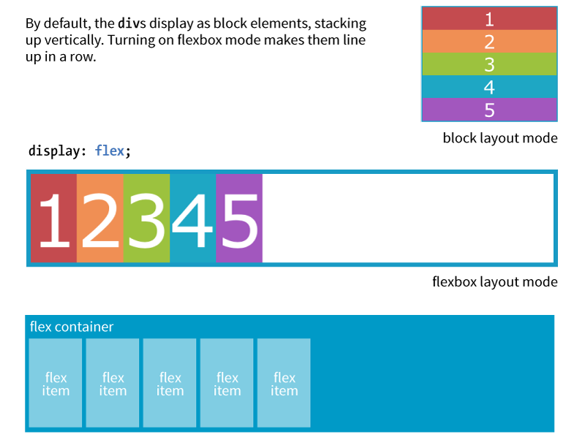
Flexbox Container (cont’d)

Slide 49
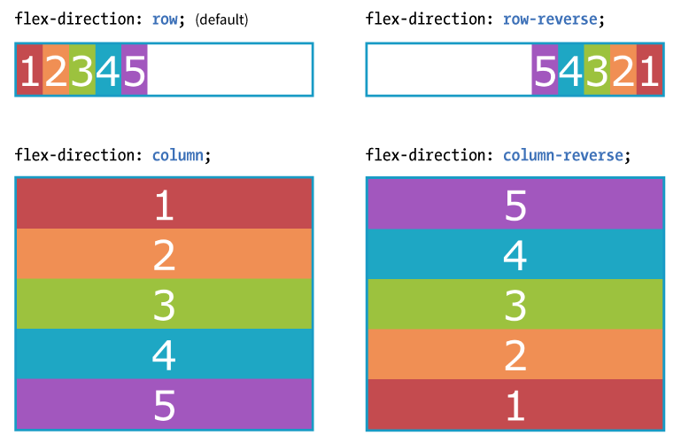
Rows and Columns (Direction)
flex-direction
Values: row, column, row-reverse, column-reverse
The default value is row (for L-to-R languages), but you can change the direction so items flow in columns or in reverse order:

Slide 50
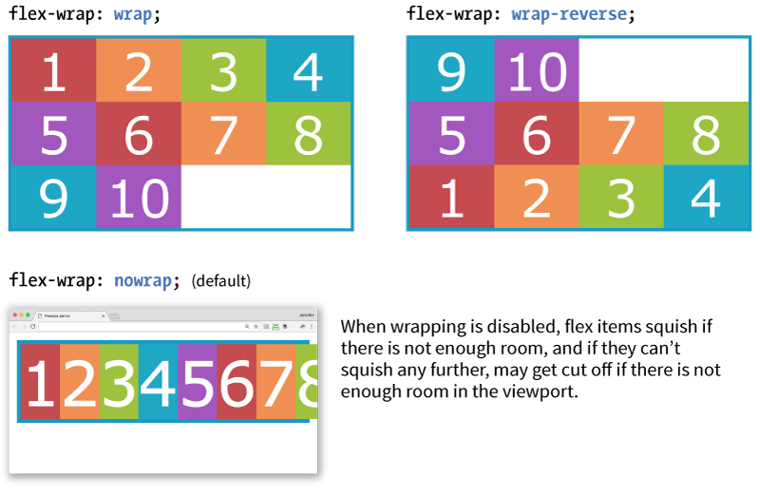
Wrapping Flex Lines
flex-wrap
Values: wrap, nowrap, wrap-reverse
Flex items line up on one axis, but you can allow that axis to wrap onto multiple lines with the flex-wrap property:

Slide 51
Flex Flow (Direction + Wrap)
flex-flow
Values: Flex-direction flex-flow
The shorthand flex-flow property specifies both direction and wrap in one declaration.
Example
#container {
display: flex;
height: 350px;
flex-flow: column wrap;
}

Slide 52
Flexbox Alignment Terminology
Flexbox is “direction-agnostic,” so we talk in terms of main axis and cross axis instead of rows and columns.
The main axis runs in whatever direction the flow has been set.
The cross axis runs perpendicular to the main axis.
Both axes have a start, end, and size.

Slide 53
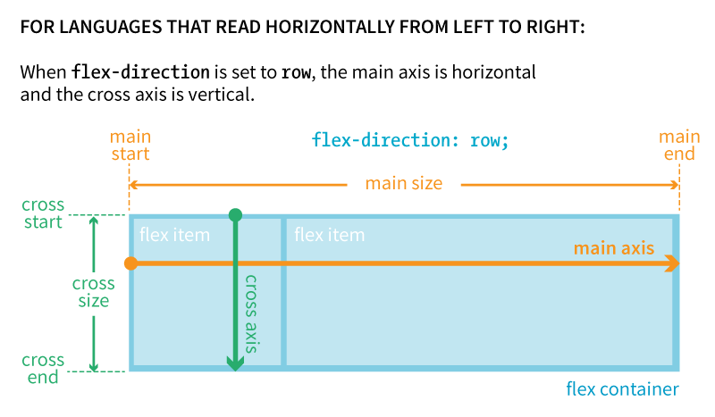
ROW: Main and Cross Axes

Slide 54
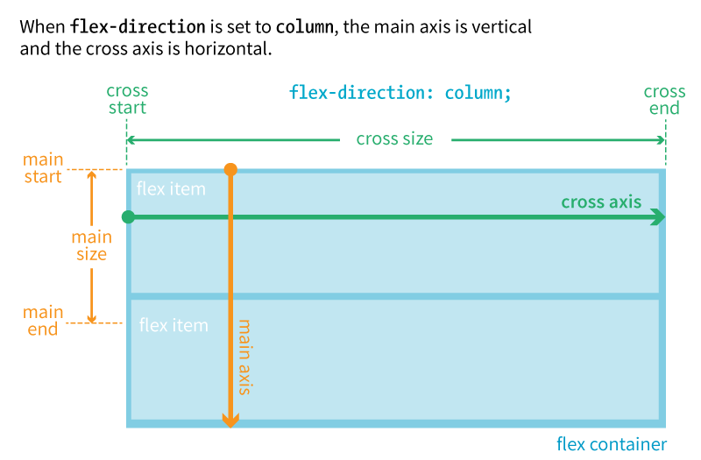
COLUMN: Main and Cross Axes

Slide 55
Aligning on the Main Axis
justify-content
Values: flex-start, flex-end, center, space-between, space-around
When there is space left over on the main axis, you can specify how the items align with the justify-content property (notice we say start and end instead of left/right or top/bottom).
The justify-content property applies to the flex container.
Example:
#container {
display: flex;
justify-content: flex-start;
}

Slide 56
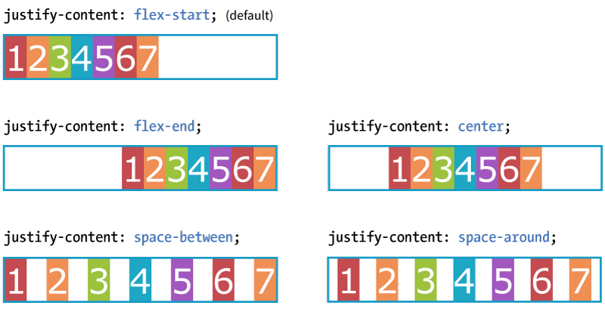
Aligning on the Main Axis (cont’d)
When the direction is row, and the main axis is horizontal

Slide 57
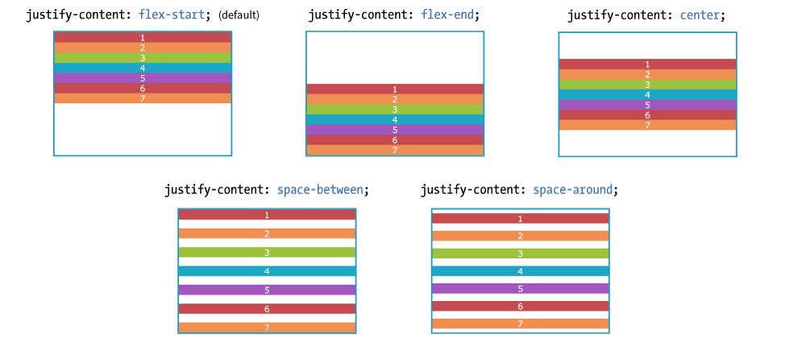
Aligning on the Main Axis (cont’d.)
When the direction is column, and the main axis is vertical
NOTE: I needed to specify a height on the container to create extra space on the main axis. By default, it’s just high enough to contain the content.

Slide 58
A WORD FROM THE AUTHOR
“Keeping the main and cross axes straight in your mind when changing between rows and columns is one of the trickiest parts of using Flexbox.
Once you master that, you’ve got it!”
—Jennifer Robbins

Slide 59
Aligning on the Cross Axis
align-items
Values: flex-start, flex-end, center, baseline, stretch
When there is space left over on the cross axis, you can specify how the items align with the align-items property.
The align-items property applies to the flex container.
Example:
#container {
display: flex;
flex-direction: row;
height: 200px;
align-items: flex-start;
}

Slide 60
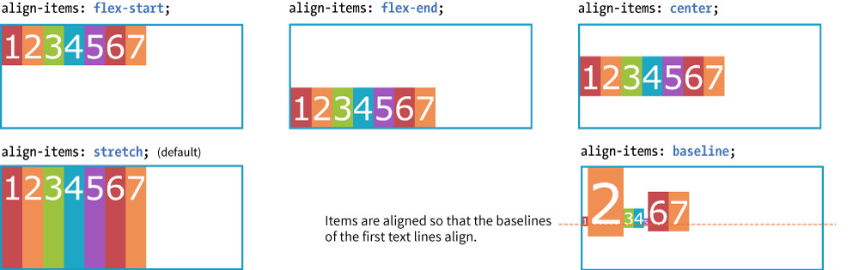
Aligning on the Cross Axis (cont’d)
When the direction is row, the main axis is horizontal, and the cross axis is vertical.
NOTE: I needed to specify a height on the container to create extra space on the cross axis. By default, it’s just high enough to contain the content.

Slide 61
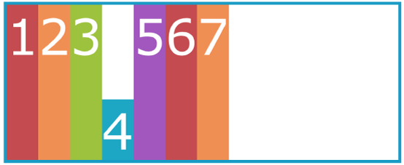
Aligning on the CROSS Axis (cont’d)
align-self
Values: flex-start, flex-end, center, baseline, stretch
Aligns an individual item on the cross axis. This is useful if one or more items should override the align-items setting for the container.
The align-self property applies to the flex item.
Example:
.box4 {
align-self: flex-end;
}

Slide 62
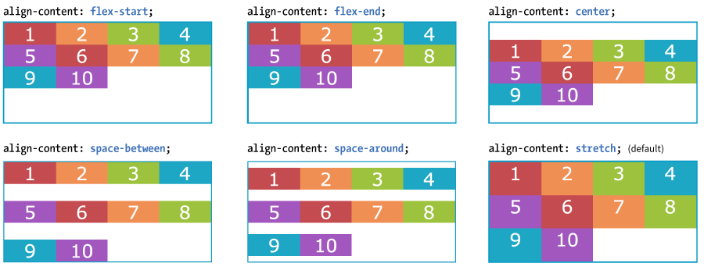
Aligning on the CROSS Axis (cont’d)
align-content
Values: flex-start, flex-end, center, space-around, space-between, stretch
When lines are set to wrap and there is extra space on the cross axis, use align-content to align the lines of content.
The align-content property applies to the flex container.

Slide 63
Aligning with Margins
Use a margin (set to auto) to put extra space on the side of particular flex items.
Example: Adding an auto margin to the right of the first flex item (the li with the logo) pushes the remaining li to the right:
ul {
display: flex;
align-items: center;
...
}
li.logo {
margin-right: auto;
}

Slide 64
Specifying How Items “Flex”
flex
Values: none, 'flex-grow flex-shrink flex-basis'
Items can resize (flex) to fill the available space on the main axis in the container.
The flex property identifies how much an item can grow and shrink and identifies a starting size
It distributes extra space in the container within items (compared to justify-content that distributes space between and around items).

Slide 65
flex Property Example
flex is a shorthand for separate flex-grow, flex-shrink, and flex-basis properties.
The values 1 and 0 work like on/off switches.
li {
flex: 1 0 200px;
}
In this example, list items in the flex container start at 200 pixels wide, are permitted to expand wider (flex-grow: 1), and are not permitted to shrink (flex-shrink: 0).
NOTE: The spec recommends always using the flex property and using individual properties only for overrides.

Slide 66
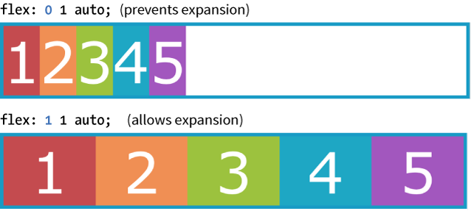
Expanding Items (flex-grow)
flex-grow
Values: Number
Specifies whether and in what proportion an item may stretch larger. 1 allows expansion; 0 prevents it.
flex-grow is applied to the flex item element.

Slide 67
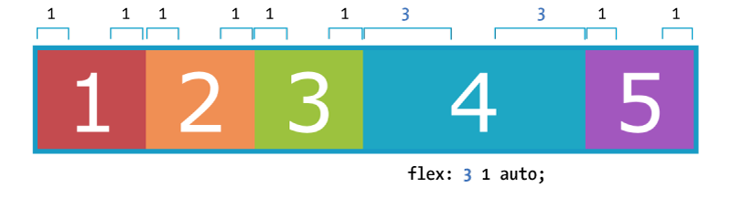
Expanding Items (cont’d)
Relative Flex
When the flex-basis has a value other than 0, higher integer values act as a ratio that applies more space within that item.
Example: A value of 3 assigns three times more space to box4 than items with a flex-grow value of 1. (Note that it isn't necessarily 3x as wide as the other items.)
.box4 { flex: 3 1 auto; }

Slide 68
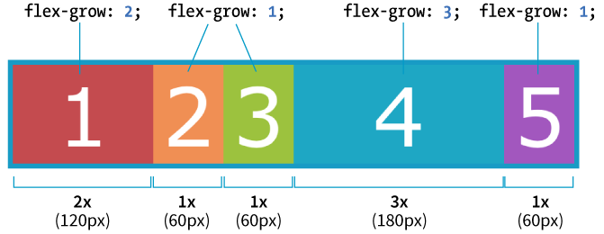
Expanding Items (cont’d.)
Absolute Flex
When the flex-basis is 0, items get sized proportionally according to the flex ratio.
Example: A value of 3 makes “box4” 3x as wide as the others when flex-basis: 0.
.box4 { flex: 3 1 0%; }

Slide 69
Shortcut flex Values
flex: initial (same as flex: 0 1 auto;) Prevents the item from growing, but allows it to shrink to fit the container
flex: auto (same as flex: 1 1 auto;) Allows items to be fully flexible as needed. Size is based on the width/height properties.
flex: none (same as flex: 0 0 auto;) Creates a completely inflexible item while sizing it to the width/height properties.
flex: integer (same as flex: integer 1 0px;) Creates a flexible item with absolute flex (so flex-grow integer values are applied proportionally)

Slide 70
Changing Item Order
order
Values: Number
Specifies the order in which a particular item should appear in the flow (independent of the HTML source order):
order is applied to the flex item element.
The default is 0. Items with the same order value are placed according to their order in the source.
Items with different order values are arranged from lowest to highest.
The specific number value doesn’t matter; only how it relates to other values (like z-index) matters.

Slide 71
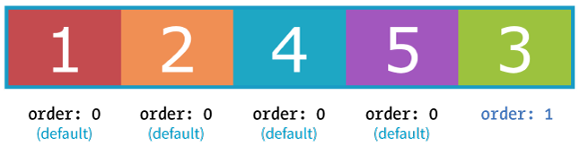
Changing Item Order (cont’d)
Example:
“box3” has a higher order value (1) than the others with default order of 0. It appears last in the line even though it’s third in the markup:
.box3 {
order: 1;
}

Slide 72
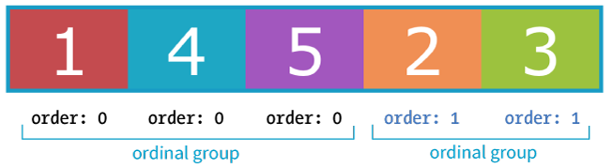
Changing Item Order (cont’d)
Ordinal groups
Items that share the same order value are called an ordinal group.
Ordinal groups stick together and are arranged from lowest value to highest:
.box2, .box3 {
order: 1;
}

Slide 73
Browser Support for Flexbox
The Flexbox spec changed over the years and was implemented by browsers along the way:
Current version (2012): display: flex; Supported by all current desktop and mobile browser versions
“Tweener” version (2011): display: flexbox; Supported by IE10 only
Old version (2009): display: box; Supported by Chrome <21, Safari 3.1–6, Firefox 2–21; iOS 3.2–6.1, Android 2.1–4.3

Slide 74
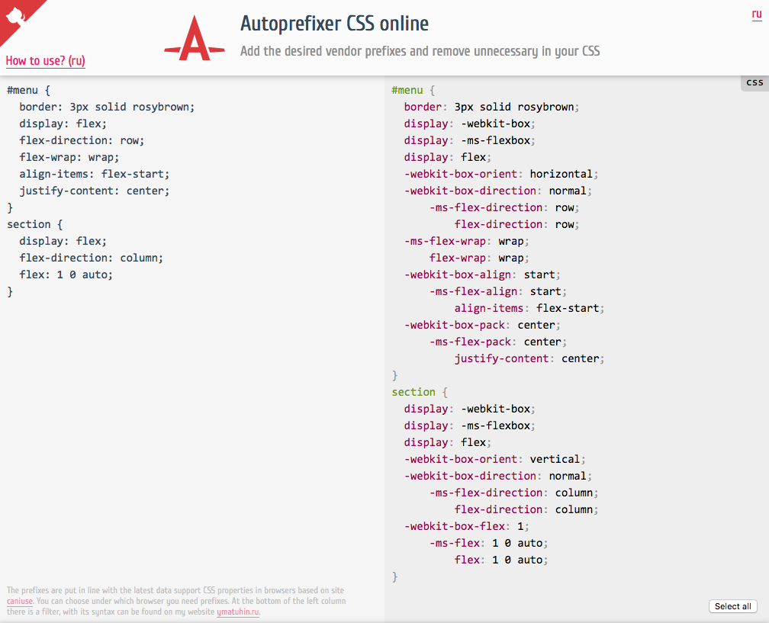
Browser Support (cont’d)
To ensure that Flexbox works across all supporting browsers, you need a lot of vendor prefixes and redundant declarations.
Use a tool like Autoprefixer to generate all that code for you (autoprefixer.github.io).

Slide 75
Flexbox Property Review
Flex container properties
display
flex-flow
flex-direction
flex-wrap
justify-content
align-items
align-content
Flex item properties
align-self
flex
flex-grow
flex-shrink
flex-basis
order

Slide 76
16B CSS LAYOUT WITH GRID

Slide 77
Grid terminology
Grid display type
Creating the grid template
Naming grid areas
Placing grid items
Implicit grid behavior
Grid spacing and alignment

Slide 78
How CSS Grids Work
Set an element’s display to grid to establish a grid container. Its children become grid items.
Set up the columns and rows for the grid (explicitly or with rules for how they are created on the fly).
Assign each grid item to an area on the grid (or let them flow in automatically in sequential order).

Slide 79
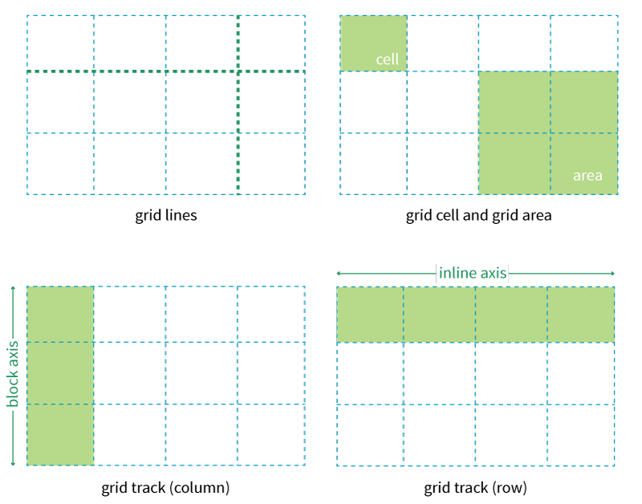
Grid Terminology

Slide 80
Creating a Grid Container
To make an element a grid container, set its display property to grid.
All of its children automatically become grid items.
The markup
<div id="layout">
<div id="one">One</div>
<div id="two">Two</div>
<div id="three">Three</div>
<div id="four">Four</div>
<div id="five">Five</div>
</div>
The styles
#layout {
display: grid;
}

Slide 81
Defining Row and Column Tracks
grid-template-rows
grid-template-columns
Values: none, list of track sizes and optional line names
The value of grid-tempate-rows is a list of the heights of each row track in the grid.
The value of grid-template-columns is a list of the widths of each column track in the grid.
#layout {
display: grid;
grid-template-rows: 100px 400px 100px;
grid-template-columns: 200px 500px 200px;
}
The number of sizes provided determines the number of rows/columns in the grid. This grid in the example above has 3 rows and 3 columns.

Slide 82
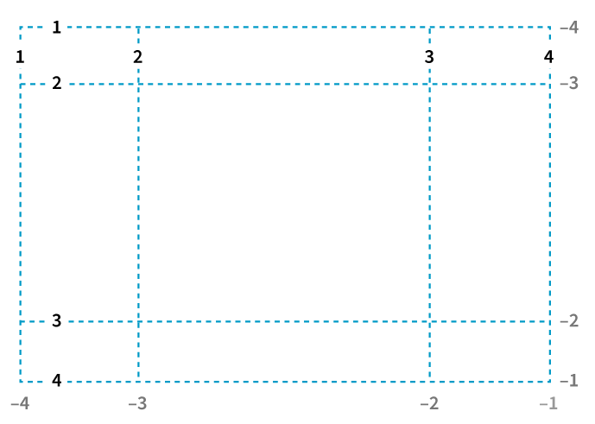
Grid Line Numbers
Browsers assign a number to every grid line automatically, starting with 1 from the beginning of each row and column track and also starting with –1 from the end.

Slide 83
Grid Line Names
You can also assign names to lines to make them more intuitive to reference later.
Grid line names are added in square brackets in the position they appear relative to the tracks.
To give a line more than one name, include all the names in brackets, separated by spaces.
#layout {
display: grid;
grid-template-rows: [header-start] 100px [header-end content-start] 400px [content-end footer-start] 100px;
grid-template-columns: [ads] 200px [main] 500px [links] 200px;
}

Slide 84
Track Size Values
The CSS Grid spec provides a lot of ways to specify the width and height of a track. Some of these ways allow tracks to adapt to available space and/or to the content they contain:
Lengths (such as px or em)
Percentage values (%)
Fractional units (fr)
minmax()
min-content, max-content
auto
fit-content()

Slide 85
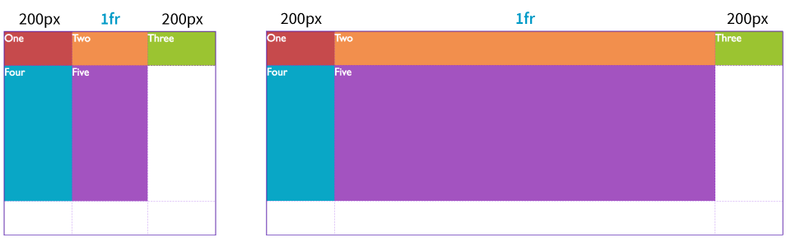
Fractional Units (fr)
The Grid-specific fractional unit (fr) expands and contracts based on available space:
#layout {
display: grid;
grid-template-rows: 100px 400px 100px;
grid-template-columns: 200px 1fr 200px;
}

Slide 86
Size Range with minmax()
The minmax() function constricts the size range for the track by setting a minimum and maximum dimension.
It’s used in place of a specific track size.
This rule sets the middle column to at least 15em but never more than 45em:
grid-template-columns: 200px minmax(15em, 45em) 200px;

Slide 87
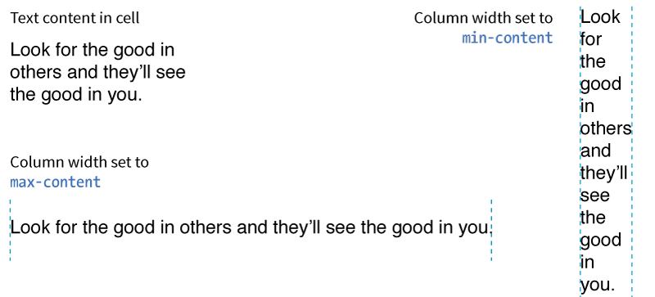
min-content and max-content
min-content is the smallest that a track can be.
max-content allots the maximum amount of space needed.
auto lets the browser take care of it. Start with auto for content-based sizing.

Slide 88
Repeating Track Sizes
The shortcut repeat() function lets you repeat patterns in track sizes:
repeat(#, track pattern)
The first number is the number of repetitions. The track sizes after the comma provide the pattern:
BEFORE: grid-template-columns: 200px 20px 1fr 20px 1fr 20px 1fr 20px 1fr 20px 1fr 20px 1fr 200px;
AFTER: grid-template-columns: 200px repeat(5, 20px 1fr) 200px;
(Here repeat() is used in a longer sequence of track sizes. It repeats the track sizes 20px 1fr 5 times.)

Slide 89
Repeating Track Sizes (cont’d.)
You can let the browser figure out how many times a repeated pattern will fit with auto-fill and auto-fit values instead of a number:
grid-template-rows: repeat(auto-fill, 15em);
auto-fill creates as many tracks as will fit in the available space, even if there’s not enough content to fill all the tracks.
auto-fit creates as many tracks as will fit, dropping empty tracks from the layout.
NOTE: If there’s leftover space in the container, it’s distributed according to the provided vertical and horizontal alignment values.

Slide 90
Giving Names to Grid Areas
grid-template-areas
Values: none, series of area names by row
grid-template-areas lets you assign names to areas in the grid to make it easier to place items in that area later.
The value is a list of names for every cell in the grid, listed by row.
When neighboring cells share a name, they form a grid area with that name.

Slide 91
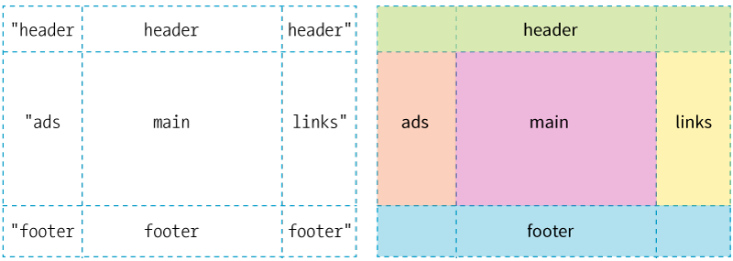
Giving Names to Grid Areas (cont’d)
#layout {
display: grid;
grid-template-rows: [header-start] 100px [content-start] 400px [footer-start] 100px;
grid-template-columns: [ads] 200px [main] 1fr [links] 200px;
grid-template-areas:
"header header header"
"ads main links"
"footer footer footer"
}

Slide 92
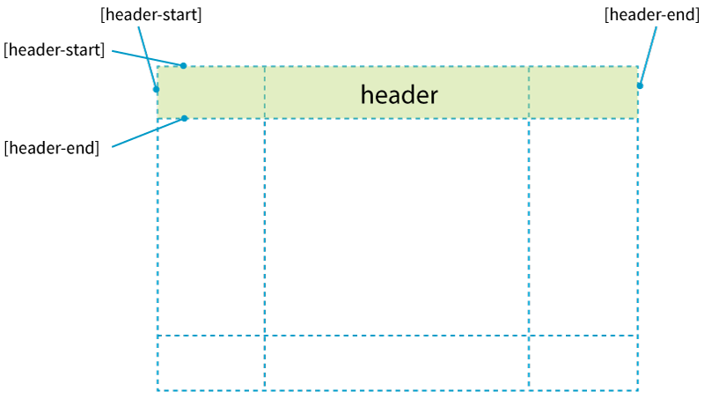
Giving Names to Grid Areas (cont’d)
Assigning names to lines with -start and -end suffixes creates an area name implicitly.
Similarly, when you specify an area name with grid-template-areas, line names with -start and -end suffixes are implicitly generated.

Slide 93
The grid Shorthand Property
grid
Values: none, row info/column info
The grid shorthand sets values for grid-template-rows, grid-template-columns, and grid-template-areas.
NOTE: The grid shorthand is available, but the word on the street is that it’s more difficult to use than separate template properties.

Slide 94
The grid Shorthand Property (cont’d)
Put the row-related values before the slash (/) and column-related values after:
grid: rows / columns
Example:
#layout {
display: grid;
grid: 100px 400px 100px / 200px 1fr 200px;
}

Slide 95
The grid Shorthand Property (cont’d)
You can include line names and area names as well, in this order:
[start line name] "area names" <track size> [end line name]
Example:
#layout {
display: grid;
grid:
[header-start] "header header header" 100px
[content-start] "ads main links" 400px
[footer-start] "footer footer footer" 100px
/ [ads] 200px [main] 1fr [links] 200px;
}
The names and height for each row are stacked here for clarity. Note that the column track information is still after the slash (/).

Slide 96
Placing Items Using Grid Lines
grid-row-start
grid-row-end
grid-column-start
grid-column-end
Values: auto, "line name", span number, span "line name", number "line name"
These properties position grid items on the grid by referencing the grid lines where they begin and end.
The property is applied to the grid item element.

Slide 97
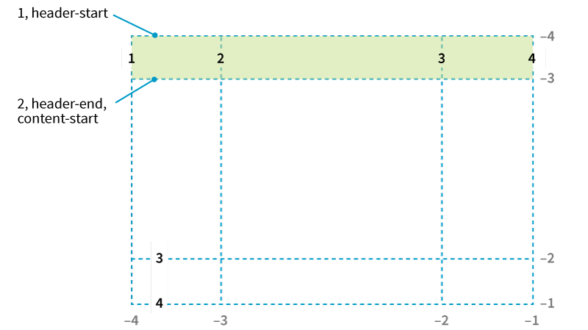
Placing Items on the Grid (cont’d)
By line number:
#one {
grid-row-start: 1;
grid-row-end: 2;
grid-column-start: 1;
grid-column-end: 4;
}
Using a span:
#one {
...
grid-column-start: 1;
grid-column-end: span 3;
}
Starting from the last grid line and spanning backward:
#one {
...
grid-column-start: span 3;
grid-column-end: -1;
}
By line name:
#one {
grid-row-start: header-start;
grid-row-end: header-end;
…
}

Slide 98
Placing Items on the Grid (cont’d)
grid-row
grid-column
Values: "start line” / “end line”
These shorthand properties combine the *-start and *-end properties into a single declaration. Values are separated by a slash (/):
#one {
grid-row: 1 / 2;
grid-column: 1 / span 3;
}

Slide 99
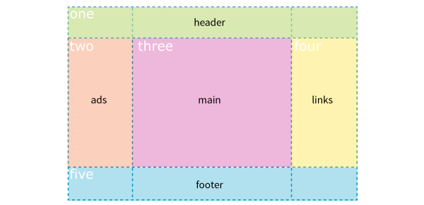
Placing Items on the Grid Using Areas
grid-area
Values: Area name, 1 to 4 line identifiers
Positions an item in an area created with grid-template-areas:
#one { grid-area: header; }
#two { grid-area: ads; }
#three { grid-area: main; }
#four { grid-area: links; }
#five { grid-area: footer; }

Slide 100
Implicit Grid Behavior
The Grid Layout system does some things for you automatically (implicit behavior):
Generating “-start” and “-end” line names when you name an area (and vice versa)
Flowing items into grid cells sequentially if you don’t explicitly place them
Adding rows and columns on the fly as needed to fit items

Slide 101
Automatically Generated Tracks
grid-auto-rows
grid-auto-columns
Values: List of track sizes
Provide one or more track sizes for automated tracks. If you provide more than one value, it acts as a repeating pattern.
Example:
Column widths are set explicitly with a template, but columns will be generated automatically with a height of 200 pixels:
grid-template-columns: repeat(3, 1fr);
grid-auto-rows: 200px;

Slide 102
Flow Direction and Density
grid-auto-flow
Values: row or column, dense (optional)
Specifies whether you’d like items to flow in by row or column. The default is the writing direction of the document.
Example:
#listings {
display: grid;
grid-auto-flow: column dense;
}

Slide 103
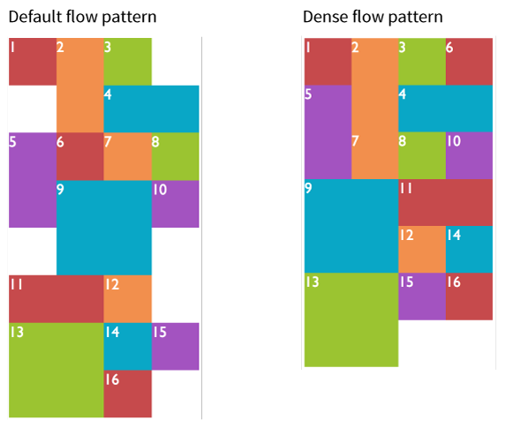
Flow Direction and Density (cont’d)
The dense keyword instructs the browser to fill in the grid as densely as possible, allowing items to appear out of order.

Slide 104
The Grid Property (Revisited)
Use the auto-flow keyword in the shorthand grid property to indicate that the rows or columns should be generated automatically.
Example: Columns are established explicitly, but the rows generate automatically. (Remember, row information goes before the slash.)
grid: auto-flow 200px / repeat(3, 1fr);
Because auto-flow is included with row information, grid-auto-flow is set to row.

Slide 105
Spacing Between Tracks
grid-row-gap
grid-column-gap
Values: Length (must not be negative)
grid-gap
Values: grid-row-gap grid-column-gap
Adds space between the row and/or columns tracks of the grid
NOTE: These property names will be changing to row-gap, column-gap, and gap, but the new names are not yet supported.

Slide 106
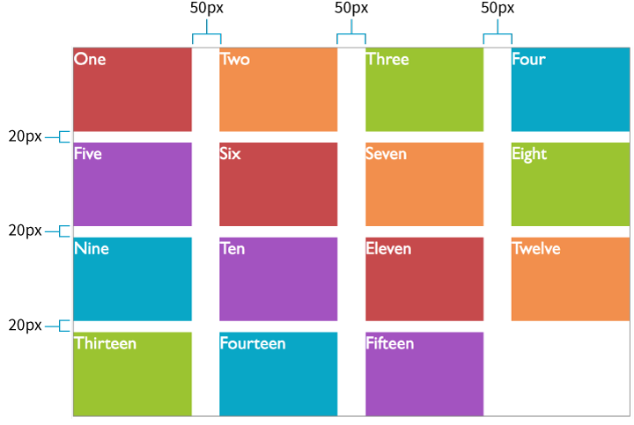
Space Between Tracks (cont’d)
If you want equal space between all tracks in a grid, use a gap instead of creating additional spacing tracks:
grid-gap: 20px 50px;
(Adds 20px space between rows and 50px between columns)

Slide 107
Item Alignment
justify-self
align-self
Values: start, end, center, left, right, self-start, self-end, stretch, normal, auto
When an item element doesn’t fill its grid cell, you can specify how it should be aligned within the cell.
justify-self aligns on the inline axis (horizontal for L-to-R languages).
align-self aligns on the block (vertical) axis.

Slide 108
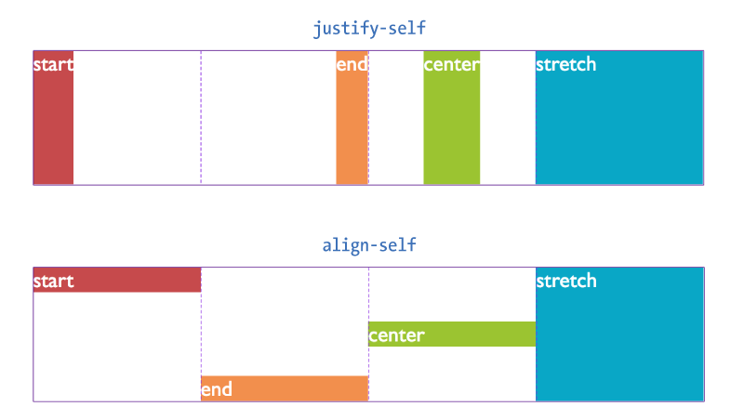
Item Alignment (cont’d)
NOTE: These properties are applied to the individual grid item element.

Slide 109
Aligning All the Items
justify-items
align-items
Values: start, end, center, left, right, self-start, self-end, stretch, normal, auto
These properties align items in their cells all at once. They are applied to the grid container.
justify-items aligns on the inline axis.
align-items aligns on the block (vertical) axis.

Slide 110
Track Alignment
justify-content
align-content
Values: start, end, center, left, right, stretch, space-around, space-between, space-evenly
When the grid tracks do not fill the entire container, you can specify how tracks align.
justify-content aligns on the inline axis (horizontal for L-to-R languages).
align-content aligns on the block (vertical) axis.

Slide 111
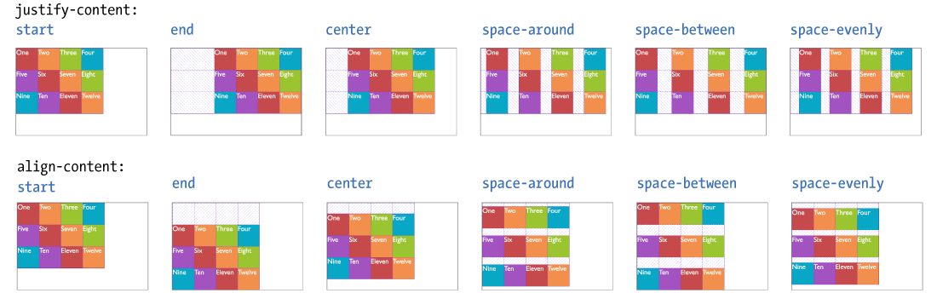
Track Alignment (cont’d)
NOTE: These properties are applied to the grid container.

Slide 112
Grid Property Review
Grid container properties
display: grid | inline-grid
grid
grid-template
grid-template-rows
grid-template-columns
grid-template-areas
grid-auto-rows
grid-auto-columns
grid-auto-flow
grid-gap
grid-row-gap
grid-column-gap
justify-items
align-items
justify-content
align-content
Grid item properties
grid-column
grid-column-start
grid-column-end
grid-row
grid-row-start
grid-row-end
grid-area
justify-self
align-self
order (not part of Grid Module)
z-index (not part of Grid Module)

Slide 113
17 RESPONSIVE WEB DESIGN

Slide 114
What RWD is
Fluid layouts
Media queries
Design strategies and patterns
Testing options

Slide 115
Introduction to RWD
RWD is a design and production approach that allows a web page to adapt to the screen it is viewed on.
The same HTML source is styled differently based on the width of the screen.
It ensures mobile users get the same content as other users, with a presentation that optimizes usability.
The term was coined by Ethan Marcotte in 2010 in his article “Responsive Web Design” for A List Apart.

Slide 116
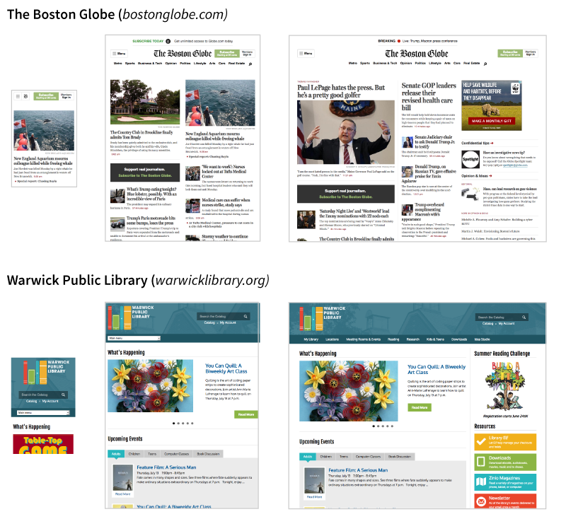
Introduction to RWD (cont’d)

Slide 117
The Components of RWD
Ethan Marcotte defines the three core components as follows:
A flexible grid Elements are sized so they squeeze and flow into the available browser space.
Flexible images Images and other embedded media scale to fit their containing elements.
CSS media queries These are a way to test for browser features such as viewport width and deliver styles accordingly.

Slide 118
Setting the Viewport
Mobile browsers render pages on a canvas called the viewport and then shrink it to fit the screen (device width).
For example, a web page be rendered on a 980-pixel viewport and shrunk down to fit a 480-pixel wide screen.
To make the viewport the same size as the device width:
<meta name="viewport" content="width=device-width, initial-scale="1">

Slide 119

Setting the Viewport (cont’d)

Slide 120

Flexible Grids (Fluid Layout)

Slide 121
Flexible Grid (Fluid Layout )
Fluid layouts are the best approach for designing for a wide range of screen widths
For flexibility, use:
fr and minmax() and content-based grid track values
flex in Flexbox
percentage measurements

Slide 122

Making Images Flexible
To make images scale down to fit the size of their container:
img { max-width: 100%; }

Slide 123
Media Queries
A media query is a special rule that tests for certain conditions before applying the styles it contains:
@media type and (feature: value) {
/* styles for browsers that meet this criteria */
}
A few query examples:
Is it on a screen or printed?
Is the browser at least a certain width?
Is the orientation landscape or portrait?

Slide 124

Media Query Example
@media screen and (orientation: landscape) {
body {
background: skyblue;
}
}
@media screen and (orientation: portrait) {
body {
background: coral;
}
}

Slide 125
Media Types
The first part of a media query identifies the media type.
The current media types are all, print, screen, and speech.
Example:
@media print {
/* print-specific styles between the brackets */
}
Media types were introduced in CSS2.

Slide 126
Media Feature Queries
CSS3 introduced media feature queries that test for a particular feature of a viewport or device.
Example: h1 headings display in Lobster font only when the viewport is at least 40em wide.
h1 {
font-family: Georgia, serif;
}
@media screen and (min-width: 40em) {
h1 {
font-family: 'Lobster', cursive;
}
}
NOTE: min-width and max-width queries are most useful for RWD.

Slide 127
Using Media Queries
In a style sheet:
Put an @media rule in a style sheet to deliver styles based on viewport width.
Make sure the @media rule comes after your baseline styles.
With external style sheets:
Link or @import separate style sheets based on a query:
<link rel="stylesheet" href="styles.css">
<link rel="stylesheet" href="2column-styles.css" media="screen and (min-width:1024px)">

Slide 128
Breakpoints
A breakpoint is the point at which we use a media query to introduce a style change.
Best practice is to create breakpoints for individual parts of the page rather than the entire page at once.
Designers generally create the narrow-screen version first and then change components as needed as the screen grows larger.
Em-based breakpoints introduce layout changes proportional to font size.

Slide 129

Breakpoints (cont’d.)
A few breakpoints used by Etsy.com (2018)

Slide 130
Designing Responsively
You need to pay attention to the following aspects of the page in a responsive design:
Content hierarchy
Layout
Typography
Navigation
Images
Special content like tables and forms

Slide 131
Content Hierarchy
The biggest challenge is deciding what is visible in the first screen on small devices.
You should strive for content parity across devices. Everyone should have access to the same information, even if it’s not in exactly the same place.
Content organization is the most important part of site planning. It’s often handled by information architects or content strategists.

Slide 132
Layout
RWD is based on fluid layouts.
The most common approach is to start with one column on small devices and add columns as space is available.
The optimum width of a text element should be based on a line length of 45 to 75 characters. If lines are much longer, introduce a breakpoint.

Slide 133

Responsive Layout Patterns

Slide 134
Typography
Typography should be optimized for different screen sizes.
Avoid complicated font styles on small screens.
Set font size to keep line lengths between 45 to 75 characters.
Line height should generally be larger on larger screens.
Left and right margins can increase on larger screens.

Slide 135

Navigation Options

Slide 136

Navigation Options (cont’d)

Slide 137
Images
Use responsive image markup techniques.
Serve the smallest file size version by default.
Make sure important image detail isn’t lost at smaller sizes. Allow zooming or provide a cropped version.
Avoid text in graphics or provide alternative versions with larger type for small screens.

Slide 138
Special Content
Forms Design for efficiency and flexibility (Flexbox)
Tables Research responsive table patterns
Interactive elements — Scale videos proportionally. — Explore alternatives that work better on small screens (for example, linking to a map app instead of just providing a small embedded map).

Slide 139
Site Testing
Testing sites in a wide variety of browsing environments is critical:
Real devices The best way to test is on actual smartphones, tablets, etc.
Emulators Use a desktop application that simulates device hardware and software.
Browser testing services Subscription-based services show how your site looks on a huge variety of browsers.

